Slide 1


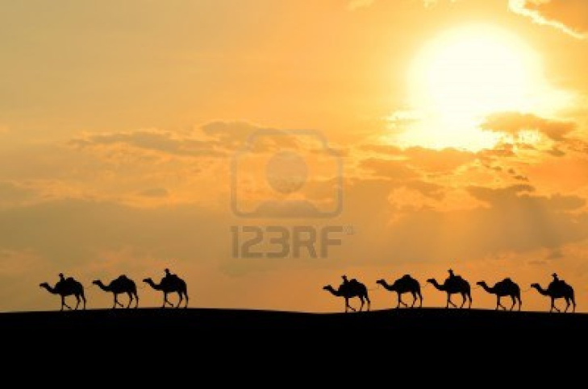
The Ventures

Slide 2
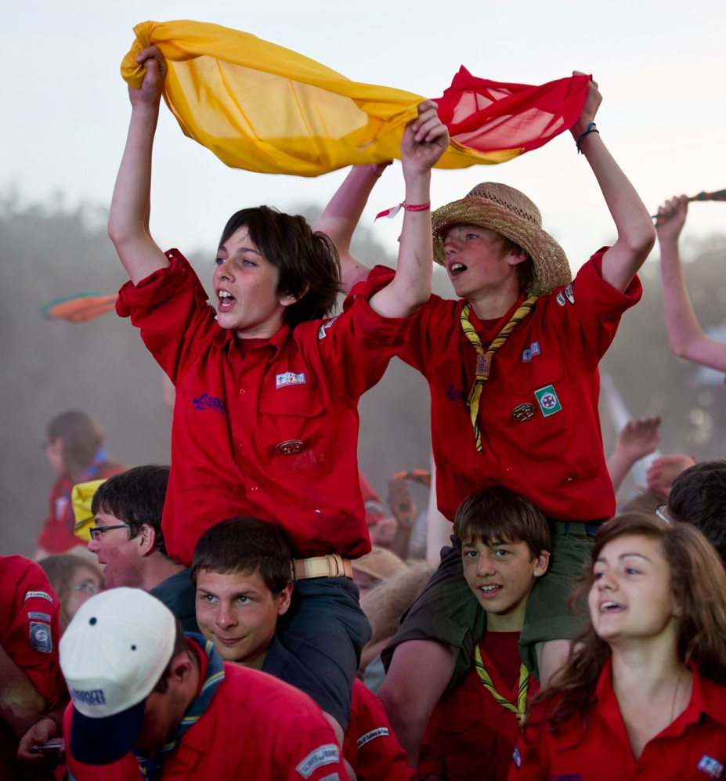
Over 10 000 young people
Aged 14 to 17 years old
Brought together to
take decisions
build a better world
Take some risks
Have new experience
Symbolic framework
To become autonomous and responsible

Slide 3
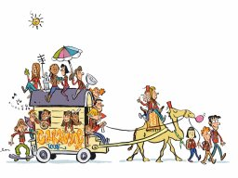
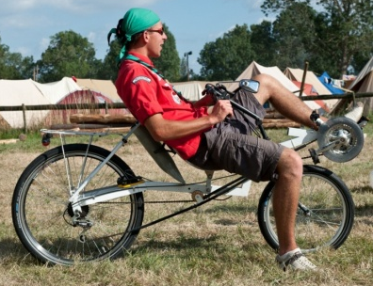
One main dynamic : the itinerancy
A venture-unit is “a Caravan”
Itinerancy aims to travel together and to foster the steps
Following a “PAC” project chosen by everyone
The PAC is voted by all the ventures from the same unit, there are several in the year (max 3) :
P
A
C
Encountering
lan
ct
elebrate
Discovering
Usefulness
Surpassing
Creating
Notes:
5 criteria on for 1 PAC
In order to enrich projects and to help teenagers to design richer and more ambitious projects, a PAC is supposed to match with the 5 following points: usefulness, discover, encounter, surpass oneself and creativity. Depending on the PAC, some of them will be more or less important. But it is really important to have them anyway.
To be useful to others (service, solidarity…) and to be useful to everyone by learning new skills, by learning know-how… to create means to change and to exchange.
Learn about a new culture, a new country, a new scout technique, a new panel of activities. Every discovery teaches you and enriches you.
To meet people from the business world, scouts and guides from others associations, sick people, children, people from different generations, from others regions… These encounters are truly important to teach young people to live in society.
To train oneself to control ones fears, to enjoy challenges, to learn how to maintain a responsibility. Be realistic, let's dare the "impossible"!
To dare his/her dream, to look for, find good solutions, to invent, to create, to express oneself through all arts… Creativity also means imagination (will the caravan be able to find a solution to its problem?)

Slide 4





5 criteria for 1 PAC
To be useful to others (service, solidarity…) and to be useful to everyone by learning new skills, by learning know-how… to create means to change and to exchange.
Learn about a new culture, a new country, a new scout technique, a new panel of activities. Every discovery teaches you and enriches you.
To meet people from the business world, scouts and guides from others associations, disable people, children, people from different generations, from others regions… These encounters are truly important to teach young people to live in society.
To train oneself to control ones fears, to enjoy challenges, to learn how to maintain a responsibility. Be realistic, let's dare the "impossible"!
To dare his/her dream, to look for, find good solutions, to invent, to create, to express oneself through all arts… Creativity also means imagination!

Slide 5
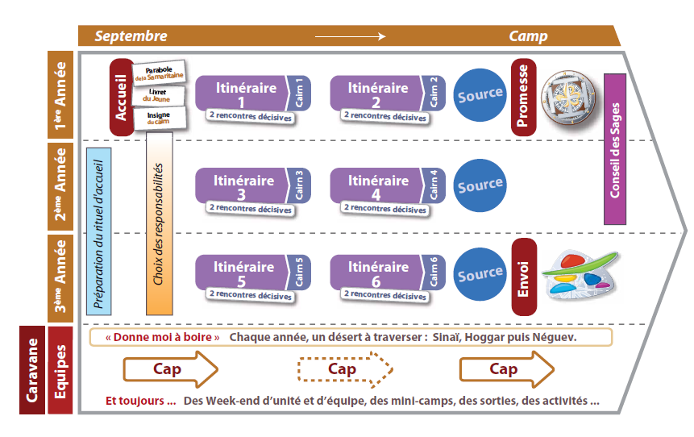
3 years in the unit
Notes:
Source: Intense time of reflection about oneself and the living environment of every venture during the camp

Slide 6
3 years in the unit
  2nd year:
  A route is a choice of personal growth in 1 of the 6 fields of development proposed in scouting. During the 3 years in the caravan each teenager is supposed to have done the 6 possible routes.
  This 2nd source is a specific time of rereading! And openness to the world.
  In pairs, leave the camp for an itinerant path and take the time to think and live a long silent time. Try to be alone and to answer the question “in what do I believe” by writing a letter to him/herself.
  3rd year: Patrol leader
The Patrol leader is a helper to the patrol’s members.
The final source consists in looking back and realising what has been lived for the past 3 years in the caravan, ask him/herself about future commitments, especially the Rover opportunity.
This source ends with the send-off ceremony to symbolise the departure of the 3rd years.
Leaders will give a parabola to each departing venture/caravel. This text is chosen by the leaders, according to the teen’s personality, to give him/her a last message before leaving the caravan.
1st year:
Welcome of the new venture to the caravan: a solemn and joyful moment at the same time
Give to the newcomers: the “Inukshuk” + the text of the Samaritan + the empty cairn
The 1st source is a time to prepare his/her promise
It’s an opportunity for the teenager to affirm him in front of the others, dare to use “I”, explain his reasons to live in the caravan and respect the law.

Slide 7

CAIRN’S STONE
The stones represent the personal and concrete success of every venture/ on his/her route.
Each venture can choose 2 cairn stones per year in which he/she is meeting 2 characters from the New testament called the “decisive encounter” and 1 contemporary character
For example: “live together”, meet Henri DUNANT fundator of the Red Cross and Judas and Barthemy

Slide 8



6 personal growth paths
Taken one by one, by every venture/caravel during the 3 years in the caravan
  “Live with energy”: do some sport, be in good health, take care of oneself, eat balanced meals.
  “Live with his/her time”: think, create, communicate, innovation, culture, open-mindedness… everything concerning the spirit
  “Live with radiance/influence” : to develop positive feelings around oneself: friendship, respect, empathy. To give and receive, identify and express what we feel.
Notes:
A route is a personal choice in 1 of the 6 growing fields of scouting. During 1 route, each teenager, backed by his/her patrol leader :
Will ask themselves personal questions and think about them,
Will be able to meet 2 characters from the New testament called the “decisive encounter” and 1 contemporary character
Will choose 1 or few concrete actions which will make them improve in the chosen field, related or not with the PAC lived by the caravan. Those actions will be even richer because they will make them meet new people and learn new skills.

Slide 9



6 personal growth paths
  “ ”Live with values”: Dare to say “I”, to speak, express oneself, be involved, act with confidence while respecting others, and compare opinions with others.
  “Live together”: live in patrol, cooperate, hold one’s place and respect the place of others, act for the well being of the group life, develop a civic awareness and active spirit
  “Live with hope”: Coordinate one’s interior life, be “looking for God”, express and share convictions and doubts, pray and celebrate individually and in a community.

Slide 10




RESPONSABILITIES
Patrol leader
They are the mission coordinators in charge of their patrol. And has to back up the patrol’s
members to help them improve. The Patrol leader is a helper to the patrol’s members,
they are supposed to know each people of their patrol better and share experiences with
them. He’s checking everything is done for the success of the project.
The nine responsibilities: to each responsibility is related a package of tasks
Accommodation responsibility
To find weekend campsites, summer camp places, trek paths…
To propose way of nature friendly transportation
Animation responsibility
Participate and help to animate the festive times of the caravan
Take care and improve the animation’s equipment for the ventures
Communication responsibility
Communicate externally about what is experienced in the caravan:
parish, local newspaper, the age-group’s scout newspaper…
Notes:
When the year starts, the 9 responsibilities are shared out amongst the caravan’s members. Preferably by the third years who are not patrol leaders. The teenager will be responsible for the task during the whole year and during the camp. Each teenager will be in charge of making sure the task associated to their responsibility is carried out correctly. Of course they can ask for help with in the caravan. Teenagers that are attributed the same responsibility have to talk together because caravan tasks usually involve more than 1 person.

Slide 11






Documentation responsibility
Hold the caravan’s book in link with the ventures responsible for communication
Look for elements needed for the caravan’s project
Equipment responsibility
To list the group’s equipment and plan its replacement
To prepare and maintain the equipment
Finance responsibility
To draw up the caravan’s budget for every activity/project
Fund-raising: sponsors, extra-job
Food responsibility
To plan balanced and varied meals for the caravan
To take care of the supply, the quality and the cleanliness of the kitchen tools
Health responsibility
To take preventive precautions inside the caravan about sanitary hazards
To take care of everyone’s health and ensure intimacy respect
Spiritual life responsibility
To guide the caravan through the desert
To organise an original way to live spirituality in the caravan

Slide 12
Live The desert
During the whole year, the unit will live spiritual times, masses, sharing times, Feedback time (alone or as a Patrol), debate times… All those tools are used to make live the spiritual proposition.
Take a break to leave better
The caravan is in the desert. Deserts are immense areas to be discovered, visited, and crossed. A hostile place by the hard climate, it asks to be tamed.
Venture has to prepare themselves to live and travel in them: every Project is made from confines, successes, moments of doubt, multiple joy.
Deserts are also a place of solitude, of withdrawal, a time of feedback. Take a break to leave better. Have the opportunity to leave behind the noise of everyday life, to take time for oneself.
The link to the nature
In this arid area, we need to know how to save water, tame the different natural elements, don’t consider things as granted. Venture makes richness that needs to be preserved, from the area they cross.
In 3 years the caravan crosses 3 deserts: Sinai, Hoggar, and Negev. All caravans in France cross the same desert during the same year. Every desert has 3 dimension:
  Sinai Desert: non chosen place, temptation place and revelation place
  Hoggar Desert: truth, stand back and brotherhood place
  Negev Desert: detachment, transit and decision place

Slide 13
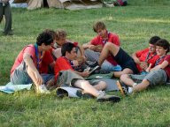
Experience patrol activities
Patrols are the centre of the pedagogical proposition of the pioneers and caravels. It’s the engine of the caravan’s activities. It’s mandatory to propose activities as a patrol to teenagers seeking autonomy in a safe context.
Patrol weekends
They are in the centre of the patrol’s life and take place once every half-year. It’s an opportunity to meet as a patrol, to go camping, to talk, to get to know each other better, but also to work on the Patrol’s missions for the PAC, to perform a service activity, an exploration in nature. Weekends have to be planned and defined together with the leaders.
The Patrol’s missions
In order for a PAC to succeed, each patrol is in charge of 1 or a few missions. It’s important to understand what is needed and why: what’s the use of this mission… the more precise we are, the more efficient it will be. Then, patrols should be trained to succeed, individually and as a patrol. There are surely things to be learned from skilled people in the scout's parent network for example. After that, the tasks only need to be distributed amongst the patrols, to be prepared at the right time.
The Trek
It’s an exploration time. Prepared and with set rules, it allows each patrol to
leave and discover new landscapes and to meet new people autonomously
for 2 or 3 days.

Slide 14
Experience the councils
Councils are made to be the places for decision and evaluation. It’s a place to live democracy.
The various councils:
The PAC council
It gathers the 3rd years, the patrol leaders and the leaders are members of this council. Decisions concerning the organization of the PAC are made during this council (schedule, communication, different tasks...).
The caravan council
All members of the caravan to choose the PAC and discusses important decisions.
The wise's council
At the end of the summer camp it gathers all ventures and caravel who are not leaving the caravan. During this meeting, the caravan chooses the patrol leaders for the following year. Before the vote, every candidate presents him/herself and explains why he/she would like to take this responsibility. During the camp, leaders can encourage one or another teenager to be a candidate for the patrol leader role if they feel the teenager ready and able to take this responsibility.

Slide 15




Missions
Participation, speak up and communication
At this time of global communication, “to be free” comes through learning to master informatics, radio or TV, Internet with its blogs and its websites.
Gospel and scout life
Religion gives meaning to our acts and relates ourselves to others and to God. To attend pilgrimages, to animate masses, to encounter new religions, create Gospel experiences.
Construction and manufacturing
Use of hands developed Man’s intelligence… so we shouldn’t hesitate! So let’s make woodcraft, let’s design new of way of ecologic transportation, let’s try the “recup’art” (concept of making art from rubbish, or with items which were supposed to be binned) A PAC which allows each and every one to create and be proud of him/herself.
Environment
In the 21st Century, it’s a human duty: understand and preserve the ecological balances, develop the environmental quality of his/her area, rural or urban, choose his/her own way of life respecting sustainable development…
Notes:
For every PAC, missions are given to Patrols. The patrol leader shares them between the members of his/her patrol, to improve the project. It can be an individual or a patrol mission, short or long. It can be related to the responsibilities, the routes, or needing an external support. Moreover the 9 responsibilities of the caravan support the PAC’s organisation the whole year long.

Slide 16

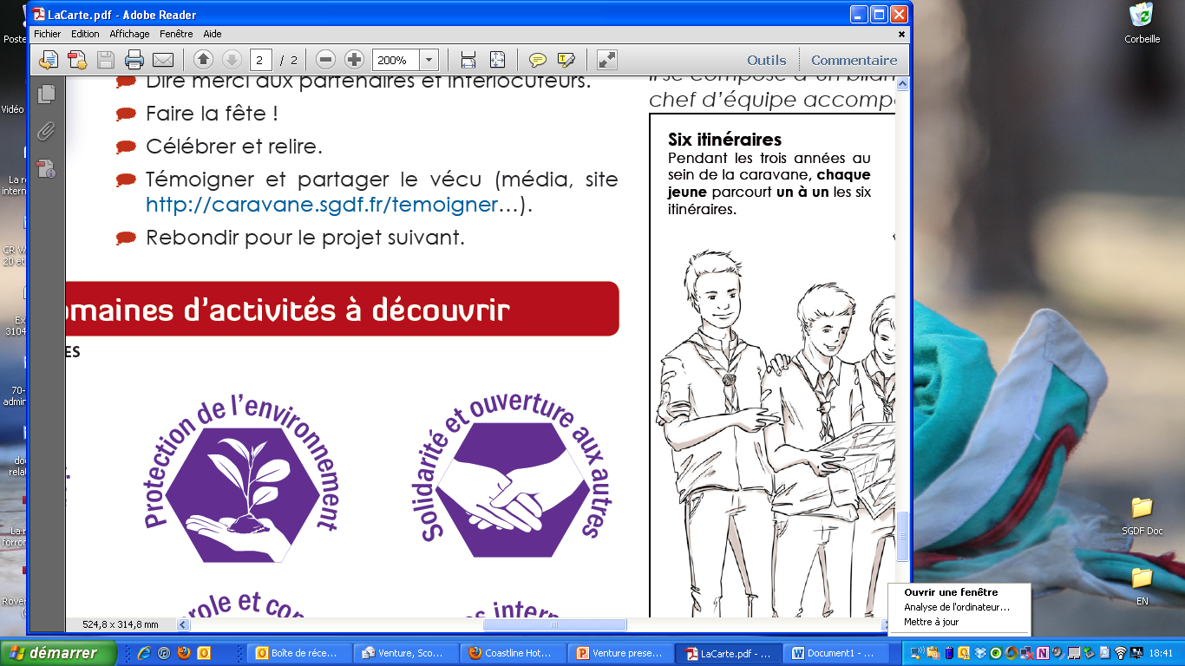


Missions
Adventure and Life in nature
Develop our physical capacities, contemplate Nature’s harmony and force, camp in the trees, travel on roads, explore caves, discover the sub-aquatic world, climb mountains, try a new sport…
Solidarity and open-mindedness (manque le symbole)
Scouting means involvement! Participate in great cases, advertising campaigns about Public Health, fight against exclusion and isolation, live concrete solidarity between generations, support and help those who need it…
Artistic Expression
To experiment different kind of artistic way , to create, to make a movie, to draw, to play
International experiences
Scouting is universal! What an opportunity to discover diversity, to meet other scout online or in real life, and build together a new and better world!

Slide 17
PAC International Twinning
In 2012, 1’260 ventures with 260 leaders went in 35 European and Mediterranean countries:
  2 or 3 weeks
  with average youth in unit: 20
  Twinning camp or jamboree or in scout base
Programmes: Twinning camp with a non-formal contract signed between the 2 units or Jamboree
French Leaders: 1 weekend training compulsory on intercultural and interreligious issues and about project management

Slide 18
PAC International Twinning
Timeline:
October-December: intention letter where the PAC motivation is written and contact with the foreign scout
January: Training for leaders
February-April: exchange with the foreign scout (contract, visit…)
April-June: Camp file to be approved by SGDF
July-August: Camp
-> Need to :
  Know early to promote foreign jamboree (in September)
  Exchange with venture commissioner about the Programme
  Facilitate the contact of local groups to twin the French venture unit
  Facilitate the contact to host foreign unit in twinning camp in France

Slide 19
Specific proposals
Top rouge cinema
Top rouge songs and music
Nature environment: forest protection in a scout base
Events’ Service: FRAT Parisian young catholic event, 2013 IPC Athletics World Championships, 24 hours of Mans
Peace light

Slide 20
LET’S WATCH THE VIDEO
http://www.dailymotion.com/video/xx35as_rejoins-nous-english-subtitles_webcam?start=16#.UYLqH0qpKFs

